Slide 1


7
Arrays
C# Programming: From Problem Analysis to Program Design
4th Edition

Slide 2
Chapter Objectives
Learn array basics
Declare arrays and perform compile-time initialization of array elements
Access elements of an array
Become familiar with methods of the Array class

Slide 3
Chapter Objectives (continued)
Write methods that use arrays as parameters
Write classes that include arrays as members and instantiate user-defined array objects
Work through a programming example that illustrates the chapter’s concepts

Slide 4
Array Basics
Data structure that may contain any number of variables
Variables must be of same type
Single identifier given to entire structure
Individual variables are called elements
Elements accessed through an index
Index also called subscript
Elements are sometimes referred to as indexed or subscripted variables

Slide 5
Array Basics (continued)
Arrays are objects of System.Array class
Array class includes methods and properties
Methods for creating, manipulating, searching, and sorting arrays
Create an array in the same way you instantiate an object of a user-defined class
Use the new operator
Specify number of individual elements

Slide 6
Array Declaration
Format for creating an array
type [ ] identifier = new type [integral value];
Type can be any predefined types like int or string, or a class that you create in C#
Integral value is the number of elements
Length or size of the array
Can be a constant literal, a variable, or an expression that produces an integral value

Slide 7
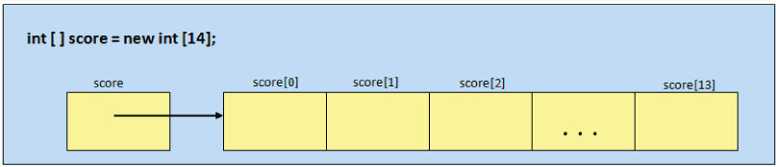
Array Declaration (continued)
Figure 7-1 Creation of an array
C# uses zero-based arrays—meaning the first element is indexed by 0

Slide 8
Array Declaration (continued)
Array identifier, name, references first element
Contains address where score[0] is located
First index for all arrays is 0
Last element of all arrays is always referenced by an index with a value of the length of the array minus one
Can declare an array without instantiating it
The general form of the declaration is:
type [ ] identifier;

Slide 9
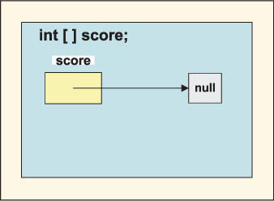
Array Declaration (continued)
Figure 7-2 Declaration of an array

Slide 10
Array Declaration (continued)
If you declare array with no values to reference, second step required – must dimension the array
General form of the second step is:
identifier = new type [integral value];
Examples
const int size = 15;
string [ ] lastName = new string [25];
double [ ] cost = new double [1000];
double [ ] temperature = new double [size];
int [ ] score;
score = new int [size + 15];
Two steps
Two steps

Slide 11
Array Initializers
Compile-time initialization
General form of initialization follows:
type[ ] identifier = new type[ ] {value1, value2, …valueN};
Values are separated by commas
Values must be assignment compatible to the element type
Implicit conversion from int to double
Declare and initialize elements in one step

Slide 12
Array Initializers (continued)
Array length determined by number of initialization values placed inside curly braces
Examples
int [ ] anArray = {100, 200, 400, 600};
char [ ] grade = new char[ ] {'A', 'B', 'C', 'D', 'F'};
double [ ] depth = new double [2] {2.5, 3};
No length specifier is required

Slide 13
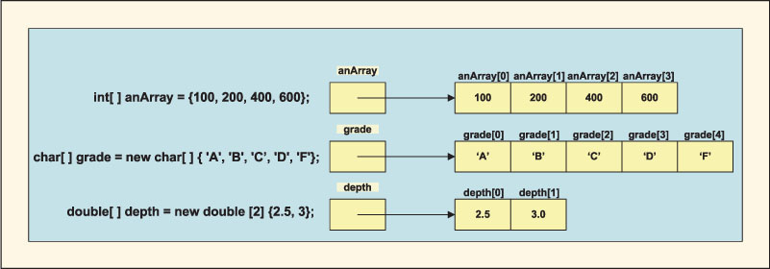
Array Initializers (continued)
Figure 7-3 Methods of creating and initializing
arrays at compile time

Slide 14
Array Access
Specify which element to access by suffixing the identifier with an index enclosed in square brackets
score[0] = 100;
Length – special properties of Array class
Last valid index is always the length of the array minus one

Slide 15
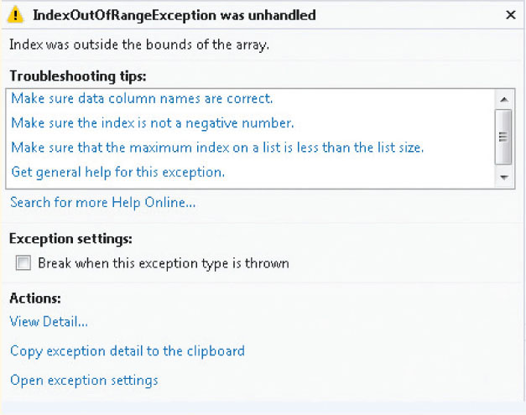
Array Access (continued)
Try to access the array using an index value larger than the array length minus one, a nonintegral index value, or a negative index value – run-time error
Figure 7-4 Index out of range exception

Slide 16
Example 7-6: Create and Use an Array
/* AverageDiff.cs Author: Doyle */
using System;
using System.Windows.Forms;
namespace AverageDiff
{
class AverageDiff
{
static void Main( )
{
int total = 0;
double avg, distance;

Slide 17
Example 7-6: Create and Use an Array (continued)
//AverageDiff.cs continued
string inValue;
int [ ] score = new int[10]; //Line 1
// Values are entered
for (int i = 0; i < score.Length; i++) //Line 2
{
Console.Write("Enter Score{0}: ", i + 1); //Line 3
inValue = Console.ReadLine( );
if (int.TryParse(inValue, out score[i]) == false)
Console.WriteLine("Invalid data entered - " +
"0 stored in array"); //Line 4
}

Slide 18
Example 7-6 Create and Use an Array (continued)
//AverageDiff.cs
// Values are summed
for (int i = 0; i < score.Length; i++)
{
total += score[i]; //Line 5
}
avg = (double) total / score.Length; //Line 6
Console.WriteLine( );
Console.WriteLine("Average: {0}", avg.ToString("F0"));
Console.WriteLine( );

Slide 19
Example 7-6 Create and Use an Array (continued)
//AverageDiff.cs continued
// Output is array element and how far from the mean
Console.WriteLine("Score\tDist. from Avg.");
for (int i = 0; i < score.Length; i++)
{
distance = Math.Abs((avg - score[i]));
Console.WriteLine("{0}\t\t{1}", score[i], distance.ToString("F0"));
}
Console.ReadKey( );
}
}
}
Review AverageDiff Example

Slide 20
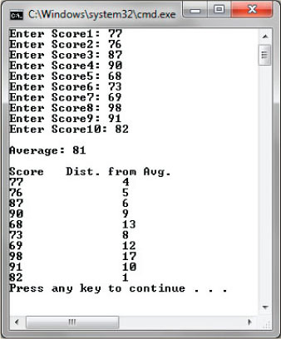
Example 7-6 Create and Use an Array (continued)
Figure 7-5 Output from AverageDiff example

Slide 21
Sentinel-Controlled Access
What if you do not know the number of elements you need to store?
Could ask user to count the number of entries and use that for the size when you allocate the array
Another approach: create the array large enough to hold any number of entries
Tell users to enter a predetermined sentinel value after they enter the last value
Sentinel value
Extreme or dummy value
Review UnknownSize Example

Slide 22
Using foreach with Arrays
Used to iterate through an array
Read-only access
General format
foreach (type identifier in expression)
statement;
Identifier is the iteration variable
Expression is the array
Type should match the array type

Slide 23
Using foreach with Arrays (continued)
string [ ] color = {"red", "green", "blue"};
foreach (string val in color)
Console.WriteLine (val);
Iteration variable, val represents a different array element with each loop iteration
No need to increment a counter (for an index)
Displays red, blue, and green on separate lines

Slide 24
Using foreach with Arrays (continued)
val is the iteration variable. It represents a different array element with
each loop iteration.
int total = 0;
double avg;
foreach (int val in score)
{
total += val;
}
Console.WriteLine("Total: " + total);
avg = (double)total / scoreCnt;
Console.WriteLine("Average: " + avg.ToString("F0"));

Slide 25
Array Class
Base array class
All languages that target Common Language Runtime
More power is available with minimal programming

Slide 26
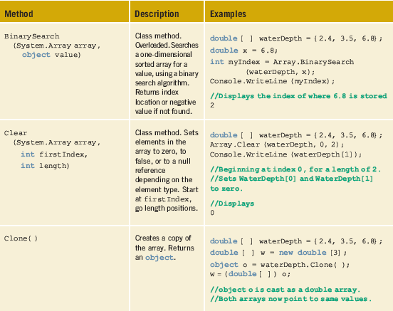
Table 7-1 System.Array methods

Slide 27
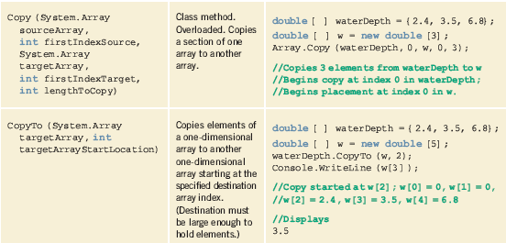
Table 7-1 System.Array methods (continued)

Slide 28
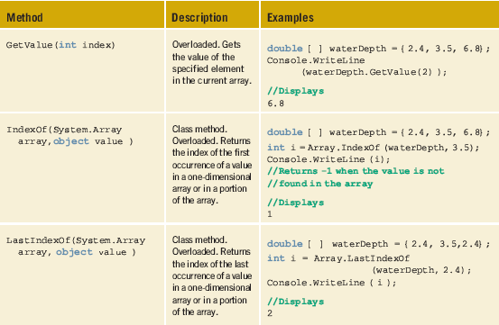
Table 7-1 System.Array methods

Slide 29
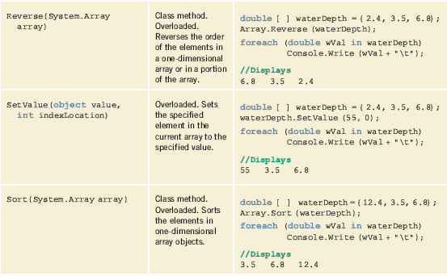
Table 7-1 System.Array methods

Slide 30
Array Class (continued)
// Copies 5 values from waterDepth, beginning at index location 2. Place
// values in Array W, starting at index location 0.
Array.Copy (waterDepth, 2, w, 0, 5);
Array.Sort (w); // Sorts Array w in ascending order
outputMsg = "Array w Sorted\n\n"; // Displays Array w sorted
foreach(double wVal in w)
{
if (wVal > 0)
outputMsg += wVal + "\n";
}
Review UsePredefinedMethods Example

Slide 31
Arrays as Method Parameters
Can send arrays as arguments to methods
Heading for method that includes array as a parameter
modifiers returnType identifier (type [ ] arrayIdentifier...)
Open and closed square brackets are required
Length or size of the array is not included
Example
void DisplayArrayContents (double [ ] anArray)

Slide 32
Pass by Reference
Arrays are reference variables
No copy is made of the contents
Array identifier memory location does not contain a value, but rather an address for the first element
Actual call to the method sends the address
Call does not include the array size
Call does not include the square brackets
Example
DisplayArrayContents (waterDepth);

Slide 33
Example 7-12: Using Arrays as Method Arguments
/* StaticMethods.cs Author: Doyle */
using System;
using System.Windows.Forms;
namespace StaticMethods
{
class StaticMethods
{
public const string caption = "Array Methods Illustrated";
static void Main( )
{

Slide 34
Example 7-12: Using Arrays as Method Arguments (continued)
double [ ] waterDepth = {45, 19, 2, 16.8, 190, 0.8, 510, 6, 18 };
double [ ] w = new Double [20];
DisplayOutput(waterDepth, "waterDepth Array\n\n" );
// Copies values from waterDepth to w
Array.Copy(waterDepth, 2, w, 0, 5);
//Sorts Array w in ascending order
Array.Sort (w);
DisplayOutput(w, "Array w Sorted\n\n" );
// Reverses the elements in Array w
Array.Reverse(w);
DisplayOutput(w, "Array w Reversed\n\n");
}
Notice DisplayOutput( ) is called with different sized arrays
Notice DisplayOutput( ) is called with different sized arrays
Notice DisplayOutput( ) is called with different sized arrays

Slide 35
Example 7-12: Using Arrays as Method Arguments (continued)
// StaticMethods.cs continued
// Displays an array in a MessageBox
public static void DisplayOutput(double [ ] anArray, string msg)
{
foreach(double wVal in anArray)
if (wVal > 0)
msg += wVal + "\n";
MessageBox.Show(msg, caption);
}
}
}
Review StaticMethods Example

Slide 36
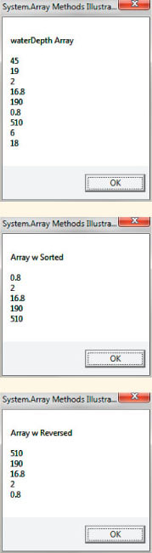
Example 7-12: Using Arrays as Method Arguments (continued)
Figure 7-6 Output from Examples 7-10 and 7-12

Slide 37
Input Values into an Array
// Instead of doing compile time initialization, input values
public static void InputValues(int [ ] temp)
{
string inValue;
for(int i = 0; i < temp.Length; i++)
{
Console.Write("Enter Temperature {0}: ", i + 1);
inValue = Console.ReadLine( );
temp[i] = int.Parse(inValue);
}
}

Slide 38
Input Values into an Array (continued)
To call InputValues(int [ ] temp) method
int [ ] temperature = new int[5];
InputValues(temperature);
Next slide, Figure 7-7, shows the result of inputting 78, 82, 90, 87, and 85

Slide 39
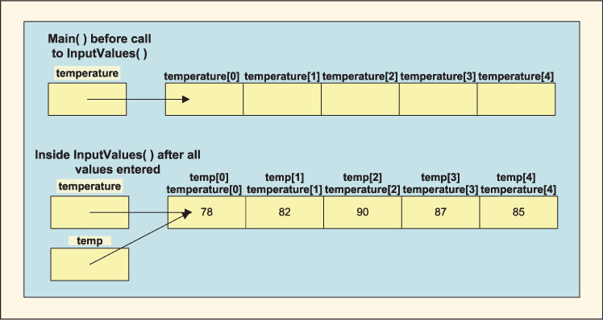
Input Values into an Array (continued)
Figure 7-7 Array contents after the InputValues( ) method is called

Slide 40
Array Assignment
Assignment operator (=) does not work as you would think
Assigned operand contains the same address as the operand on the right of the equal symbol

Slide 41
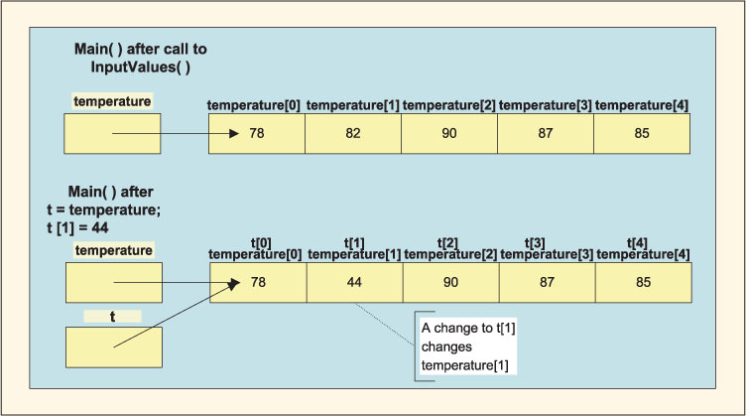
Array Assignment (continued)
Figure 7-8 Assignment of an array to reference another array

Slide 42
Passing Arrays to Methods
int [ ] temperature = new int[5];
int [ ] t = new int[5];
InputValues(temperature);
public static void InputValues (int [ ] temp)
Review PassingArray Example

Slide 43
Params Parameter
Keyword params used
Appears in formal parameter list (heading to the method)
Must be last parameter listed in the method heading
Indicates number of arguments to the method that may vary
Parallel array
Two or more arrays that have a relationship

Slide 44
Params Parameter (continued)
public static void Main( )
{
DisplayItems(1, 2, 3, 5);
int[ ] anArray = new int[5] {100, 200, 300, 400, 500};
DisplayItems(anArray);
DisplayItems(1500, anArray[1] * anArray[2]);
Console.ReadKey( );
}
public static void DisplayItems (params int[] item)
Review VaryingArguments Example

Slide 45
Arrays in Classes
Arrays can be used as fields or instance variables data members in classes
Base type is declared with other fields – but, space is allocated when an object of that class is instantiated
Example data member declaration
private int[ ] pointsScored;
Space allocated in constructor
pointsScored = new int[someIntegerValue];

Slide 46
Arrays in Classes (continued)
public class Player
{
private string lname;
private string fname;
private string id;
private int[ ] pointsScored;
private int numberOfGames;
The heading for the constructor might look like:
public Player (string ln, string fn, string iden, int [ ] s, int numGames)

Slide 47
Arrays in Classes (continued)
Parallel arrays
Two or more arrays that have a relationship
Relationship is established using the same subscript or index to refer to the elements
string [ ] firstName = new string [3] {"Bill", "Justin", "David"};
string [ ] lastName = new string [3] {"Gates", "Bieber", "Letterman"};
Especially useful for storing related data when the related data is of different types (i.e. name and points scored)

Slide 48
Array of User-Defined Objects
Create just like you create arrays of predefined types
Example
Console.Write("How many players? ");
inValue = Console.ReadLine( );
playerCnt = Convert.ToInt32(inValue);
Player[ ] teamMember = new Player[playerCnt];

Slide 49
Arrays as Return Types
Methods can have arrays as their return type
Example method heading
public static int [ ] GetScores(ref int gameCnt)
Example call to the method
int [ ] points = new int [1000];
points = GetScores(ref gameCnt);
Method would include a return statement with an array

Slide 50
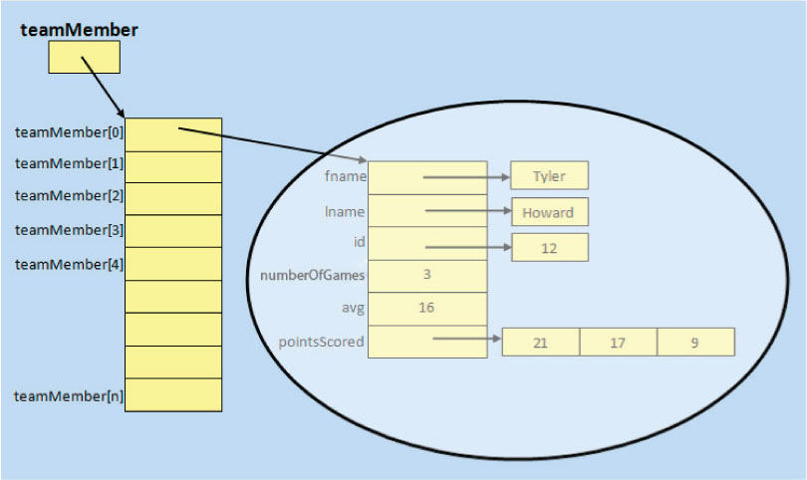
PlayerApp Use of Arrays
Figure 7-10 PlayerApp memory representation

Slide 51
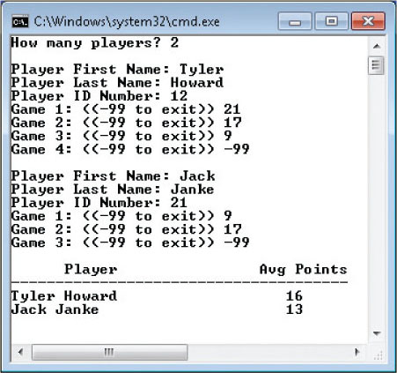
PlayerApp Use of Arrays
Figure 7-9 PlayerApp
output
Review PlayerApp Example

Slide 52
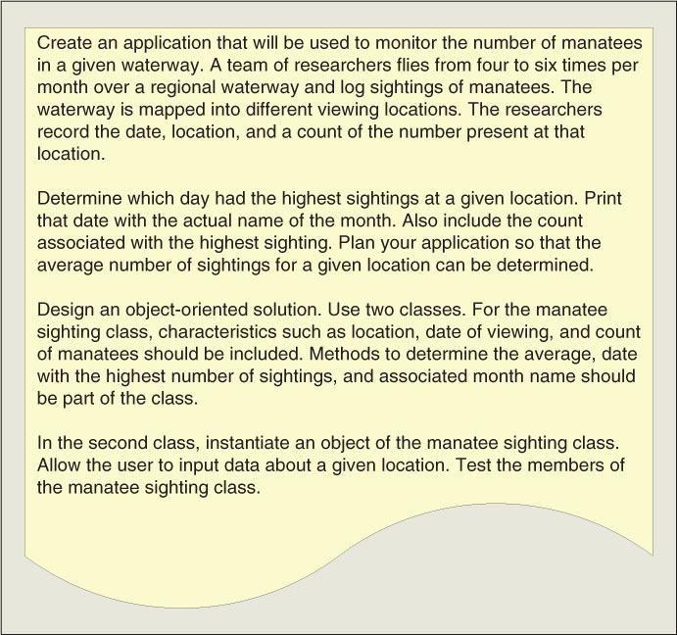
Manatee Application Example
Figure 7-11 Problem specification for Manatee example

Slide 53
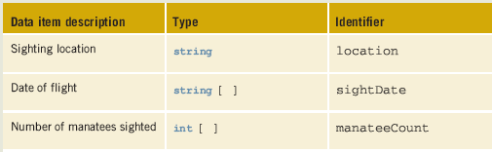
Manatee Application Example (continued)
Table 7-2 Instance field members for the ManateeSighting class

Slide 54
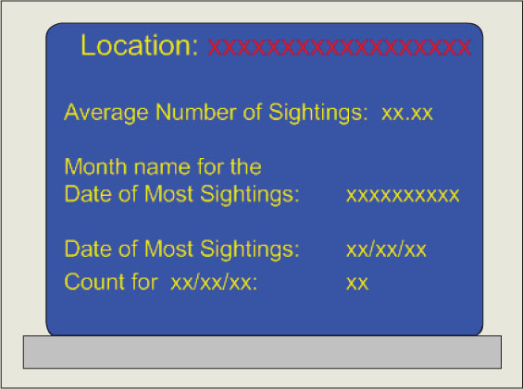
Manatee Application Example (continued)
Figure 7-12 Prototype

Slide 55
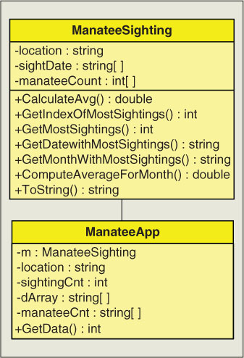
Manatee Application Example (continued)
Figure 7-13 Class diagrams

Slide 56
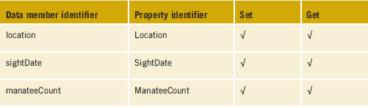
Manatee Application Example (continued)
Table 7-3 Properties for the ManateeSighting class

Slide 57
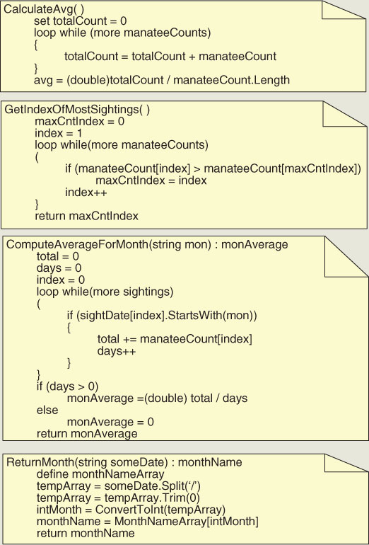
Pseudocode – Manatee Application
Figure 7-14 ManateeSighting
class methods behavior

Slide 58
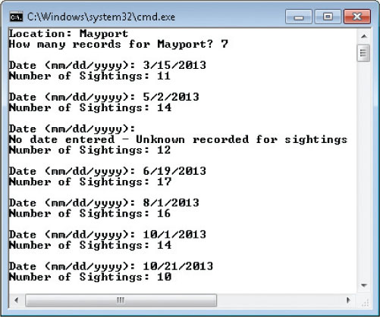
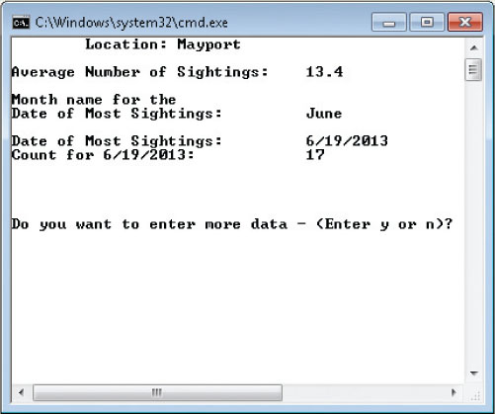
ManateeApp Application
Figure 7-15 ManateeApp
application during data entry
Figure 7-16 ManateeApp
application output
Review ManateeApp Example

Slide 59
Coding Standards
Guidelines for Naming Arrays
Singular nouns
Camel case
Place [ ] after data type
Advanced Array Suggestions
Use foreach for read-only access
Use predefined methods and properties whenever possible

Slide 60
Resources
C# Coding Conventions –
http://msdn.microsoft.com/en-us/library/ff926074.aspx
C# Corner - Arrays in C# –
http://www.c-sharpcorner.com/uploadfile/puranindia/arrays-in-C-Sharp
Code Project - Doing Arrays - C# –
http://www.codeproject.com/Articles/161465/Doing-Arrays-C
C# Dot Net Perls –
http://www.dotnetperls.com/array

Slide 61
Chapter Summary
Array declaration
Compile-time initialization
Accessing elements
Array class methods
Arrays as parameters to methods
Methods that return arrays
Classes that include array members
Instantiate user-defined array objects

